Slide 1
GEOG788P Project Update
Guimin Zhu
Nov 19, 2020

Slide 2
Project Updates
Cleaned and processed 2018 ACS data (census tract level)
Prepared the data frame
Cross walk the cases data from zip code level cases data to census tract level
Explanatory variables:
Population density
Race/ethnicity (White, Black, Asian, Native, Other)
Age groups (0-19, 20-39, 40-59, 60-79, 80+)
Population with bachelor degree or higher
Population below poverty level, Median household income, Unemployment rate
Uninsured population
Dependent variable: New COVID-19 positive cases in 03/15 – 06/30 and 07/01 – 08/31
Notes:
There are 2 spikes of COVID-19 as I presented before

Slide 3
Run OLS and Random Forest models
Filter out extreme records (1128/1394)
train-test split of 75% - 25%
5-fold cross-validation
Spatial clustering
Local Moran’s I hot spots/cold spots analysis
Regionalization with K-Nearest Neighbor matrix (k=5, 4 nearest neighbors)
Notes:
Both population and population density greater than a threshold.
Python: AgglomerativeClustering from scikit-learn with Queen contiguity (spatial weights) matrix and KNN matrix (where each observation is connected to its 4 nearest observations, instead of those it touches)
PySAL: max-p algorithm

Slide 4
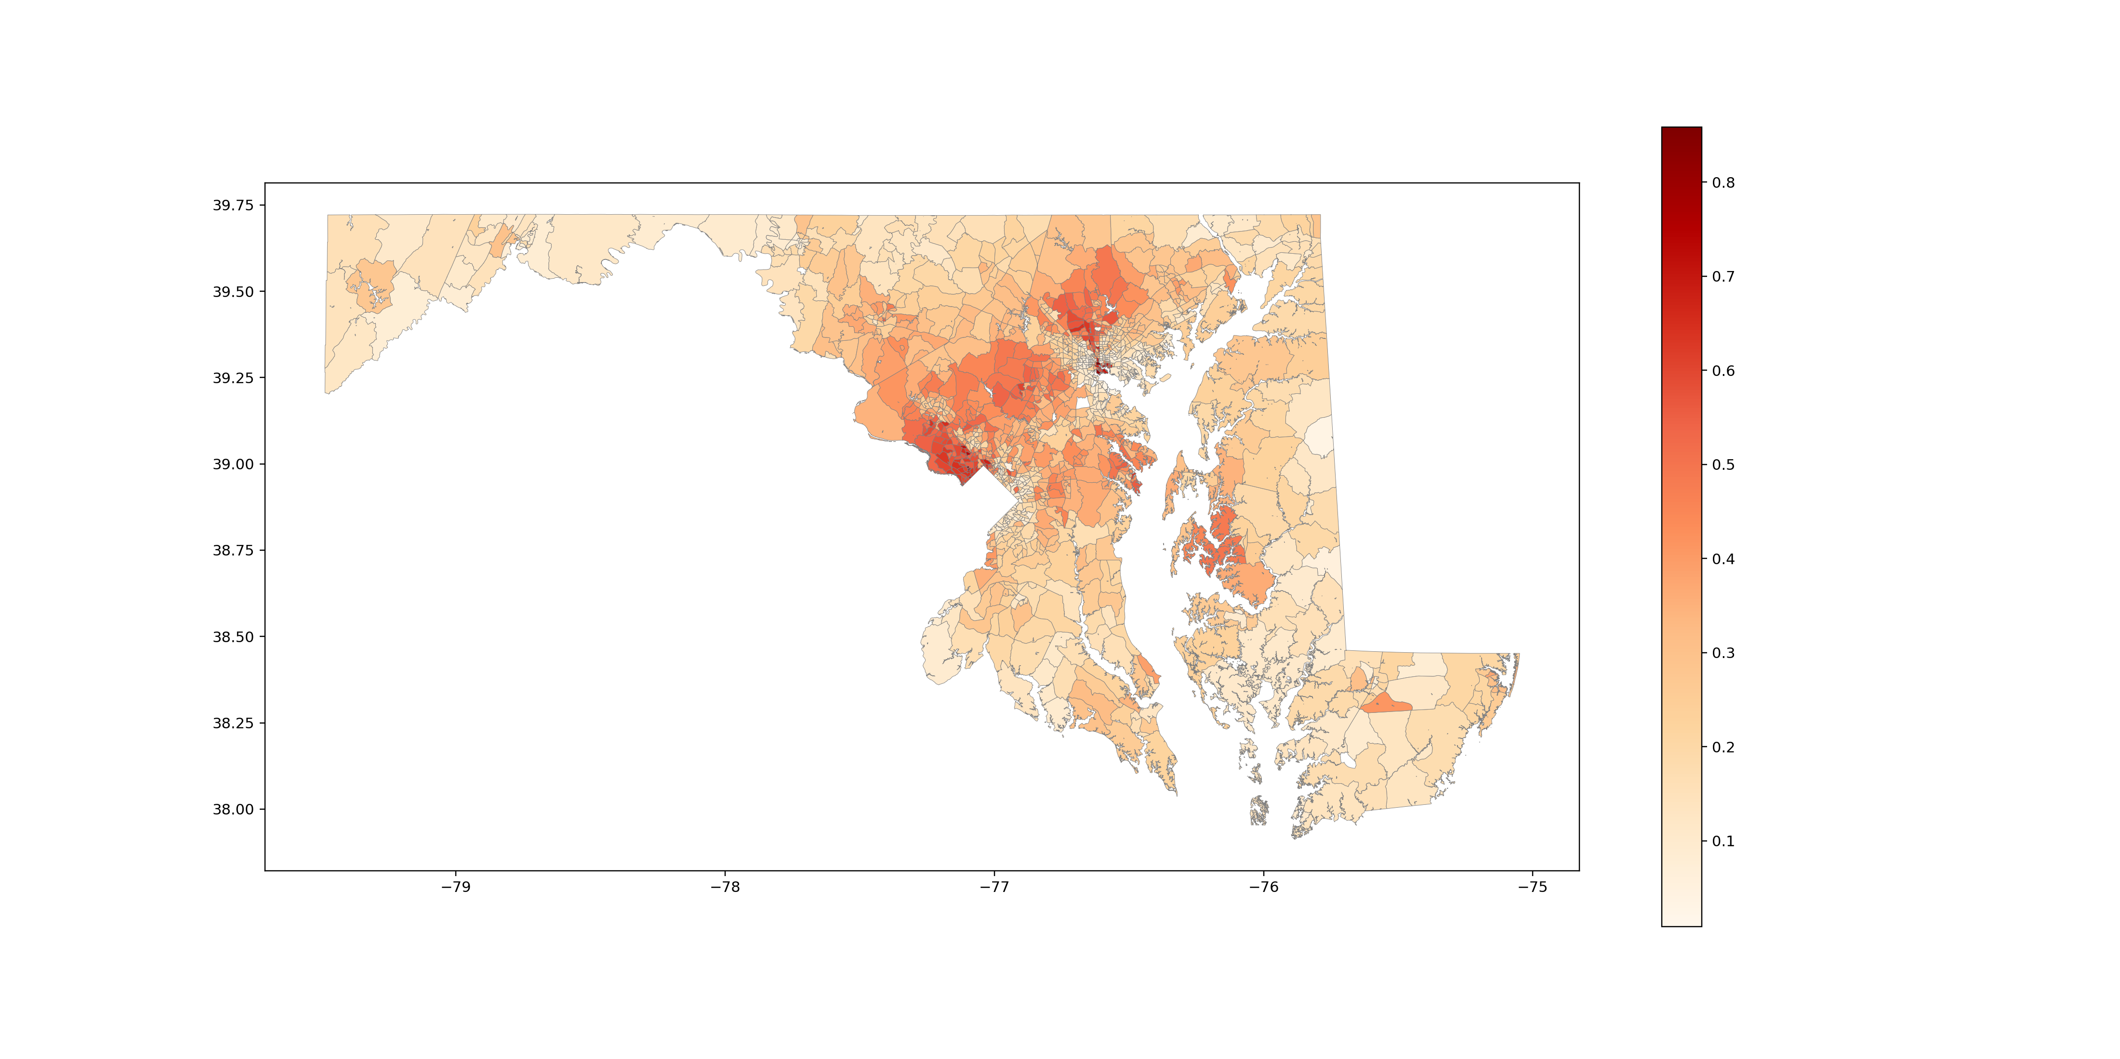
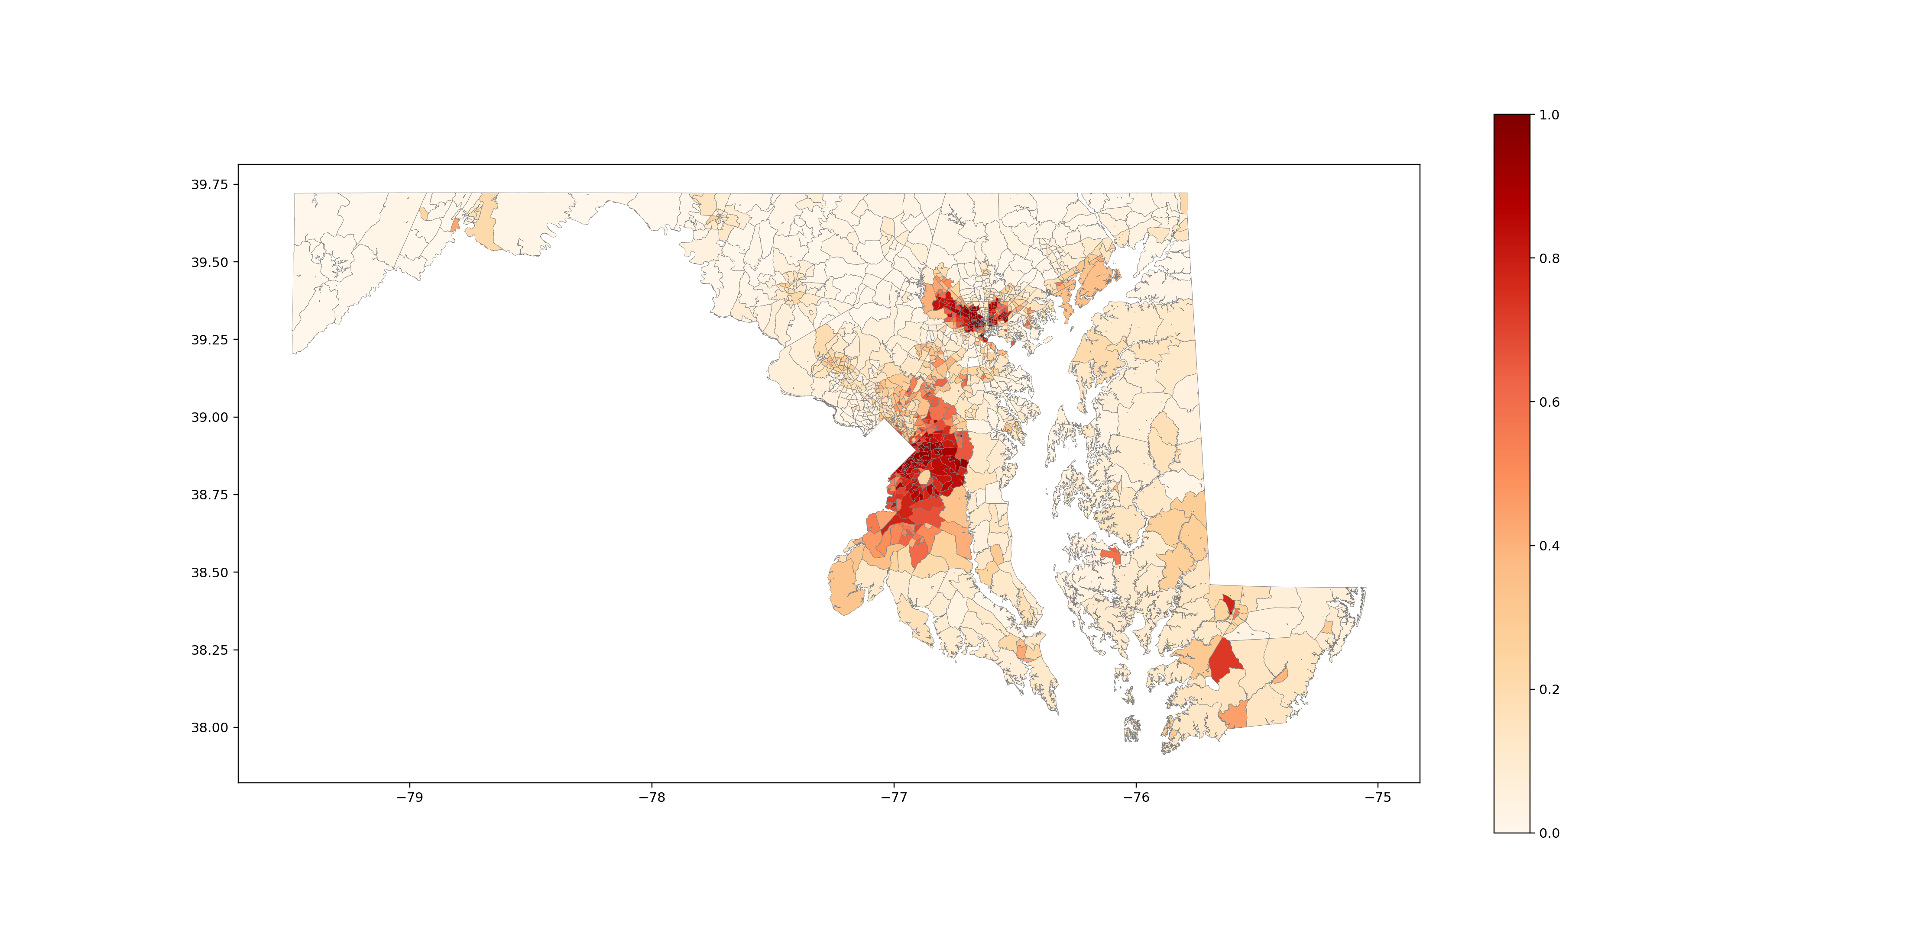
Percent of population with bachelor’s degree or higher
Percent of Black population
Notes:
Education: northwest of DC (Silver Spring and Bethesda), and northwest of Baltimore (maybe Ellicott City and Towson)
Black: Prince George’s county and the “butter-fly” patterns in Baltimore

Slide 5
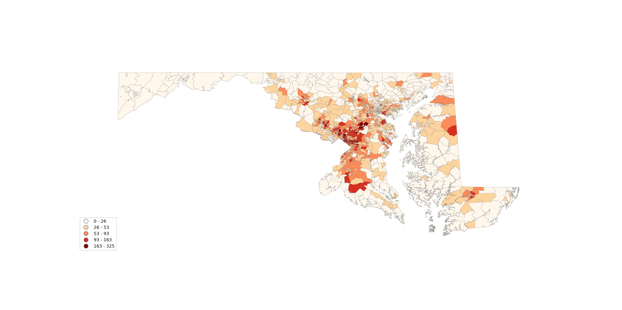
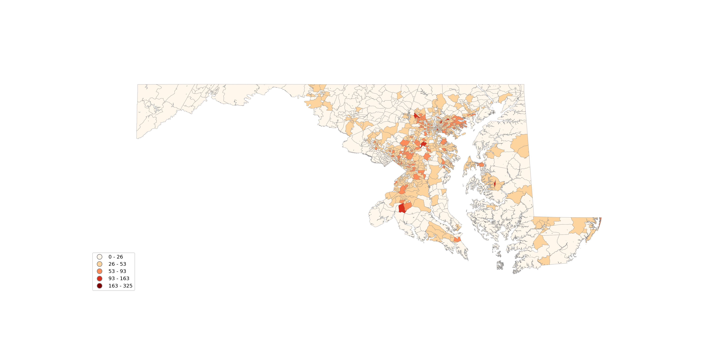
New COVID-19 positive cases 03/15 – 06/30
New COVID-19 positive cases 07/01 – 08/31
Notes:
Overall, the first period has more cases. The second period shows less cases and less hotspots

Slide 6
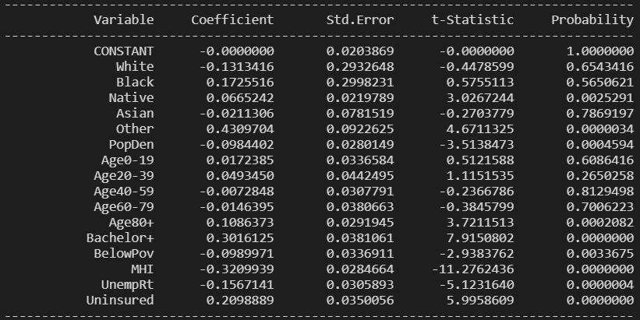
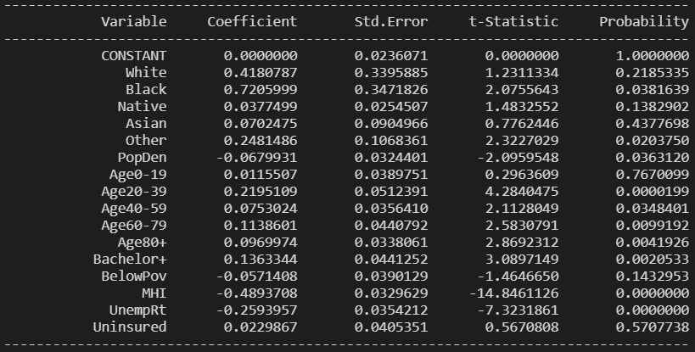
OLS for period 03/15 – 06/30
 |  | 03/15 – 06/30 | 07/01 – 08/31
R2 |  | 0.5382 | 0.3808
Adjusted R2 |  | 0.5316 | 0.3719
Top Variables | 1 | Other (+) | Black (+)
 | 2 | MHI (-) | MHI (-)
 | 3 | Uninsured (+) | White (+)
 | 4 | Black (+) | Unemployment (-)
 | 5 | Unemployment (-) | Other (+)
OLS for period 07/01 – 08/31
Notes:
No collinearity (corr>=0.75)
Notice: Whites

Slide 7
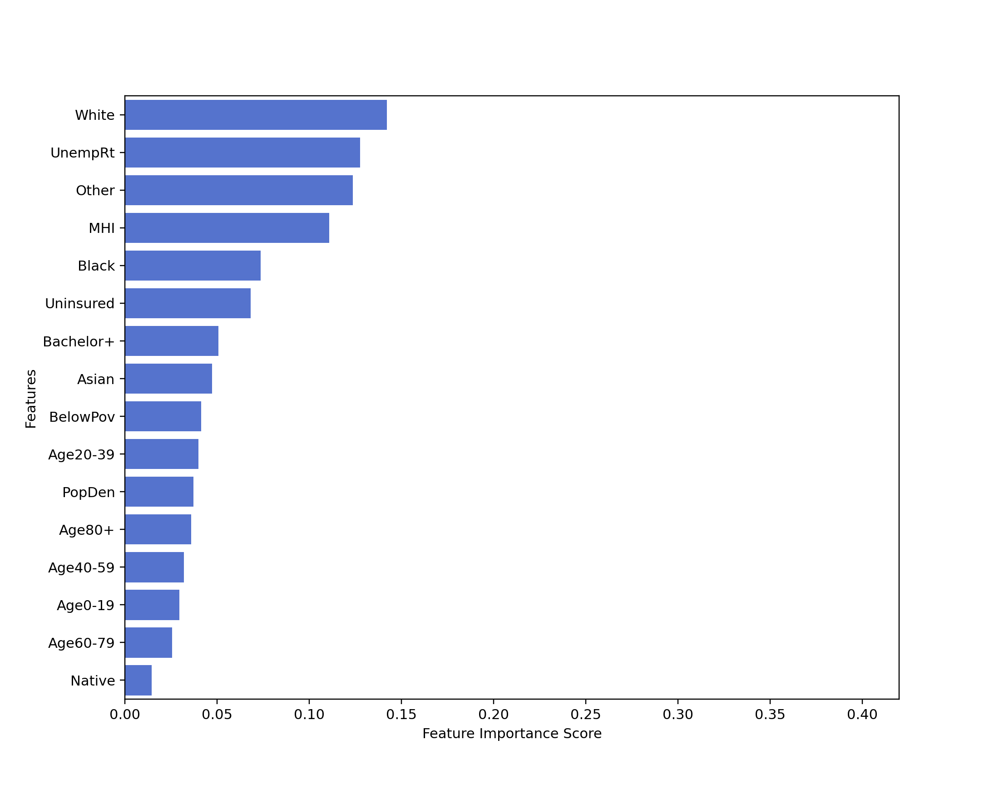
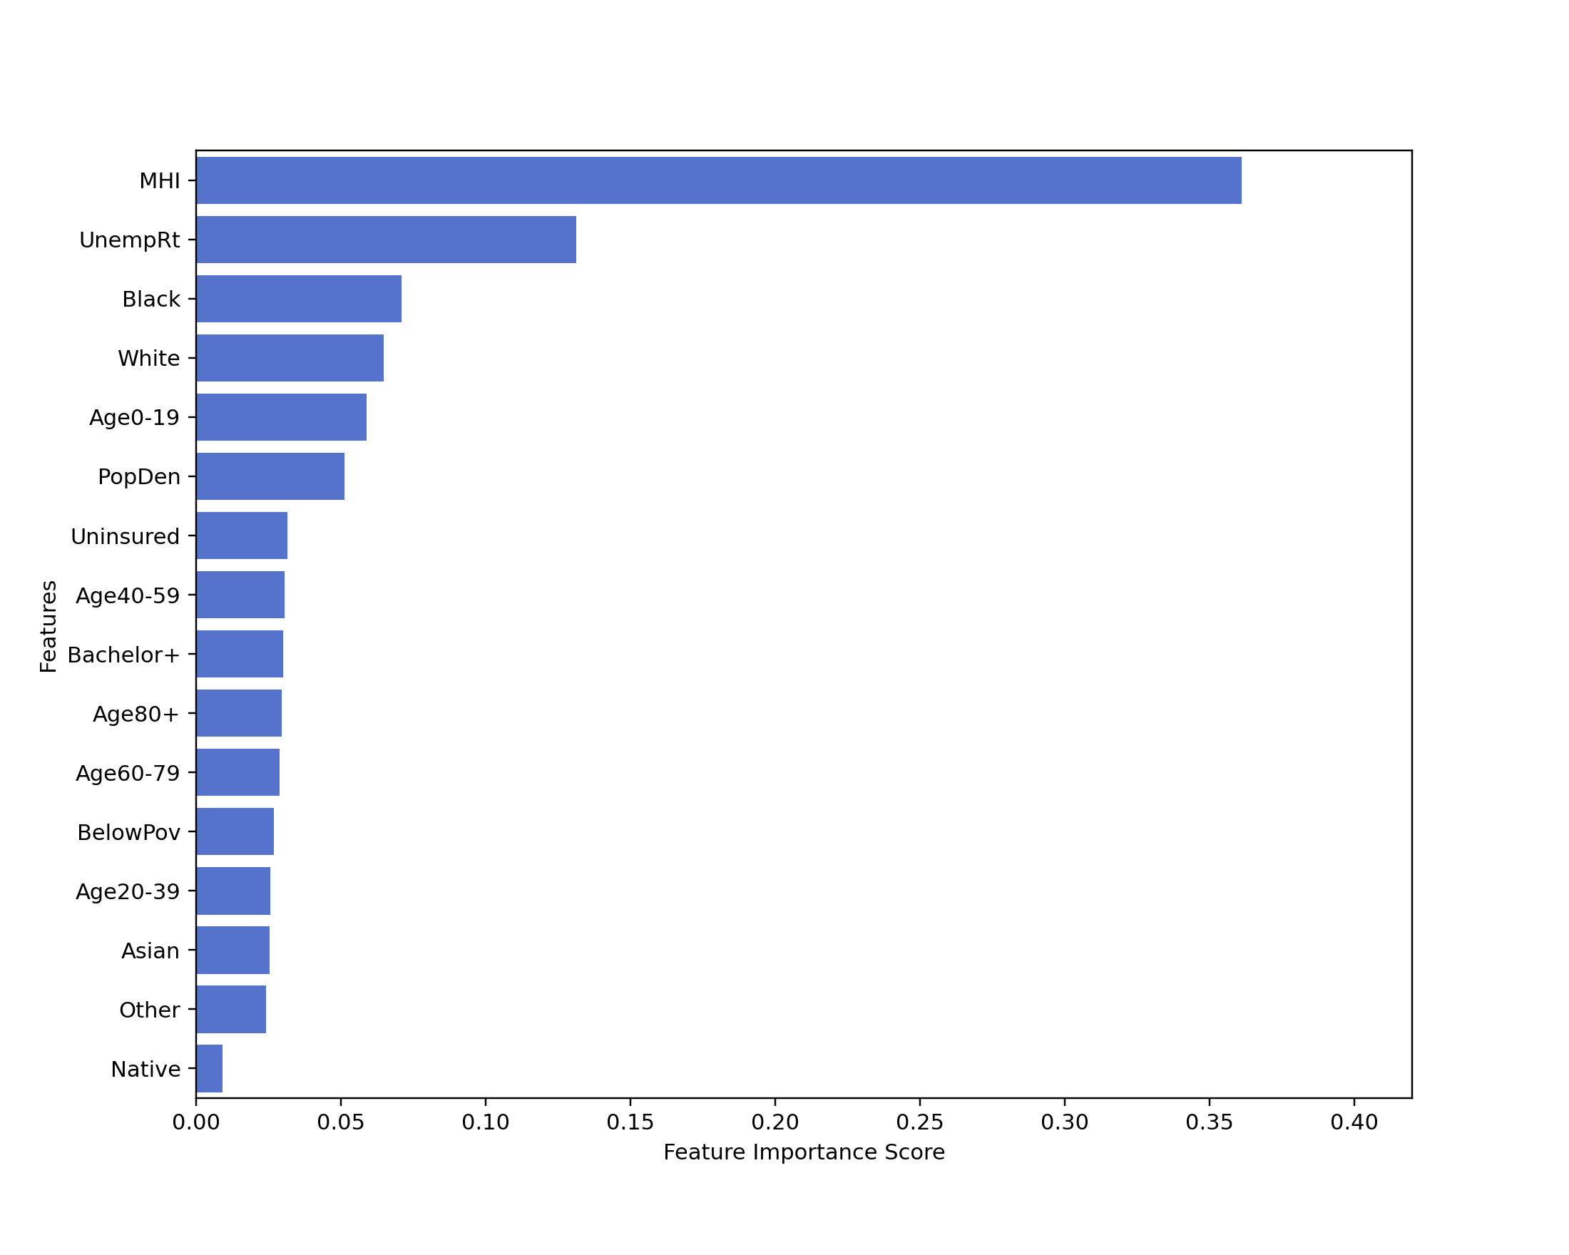
 | 03/15 – 06/30 | 07/01 – 08/31
R2 – training | 0.9113 | 0.8122
R2 – testing | 0.4182 | 0.3917
RMSE | 30.78 | 13.48
MAE | 20.22 | 9.72
Period 03/15 – 06/30
Period 07/01 – 08/31
Notes:
Overfitting: imbalanced dataset, smote & oversampling
Both top: median household income, white, unemployment rate, black
Other, 80+: top -> bottom
0-19, 40-59: going up

Slide 8
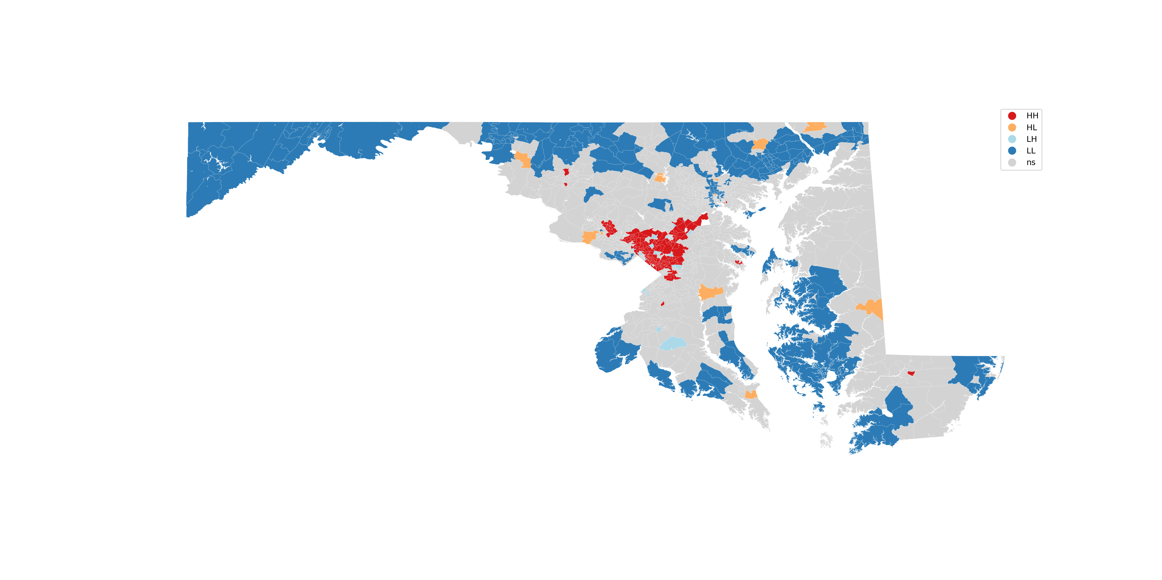
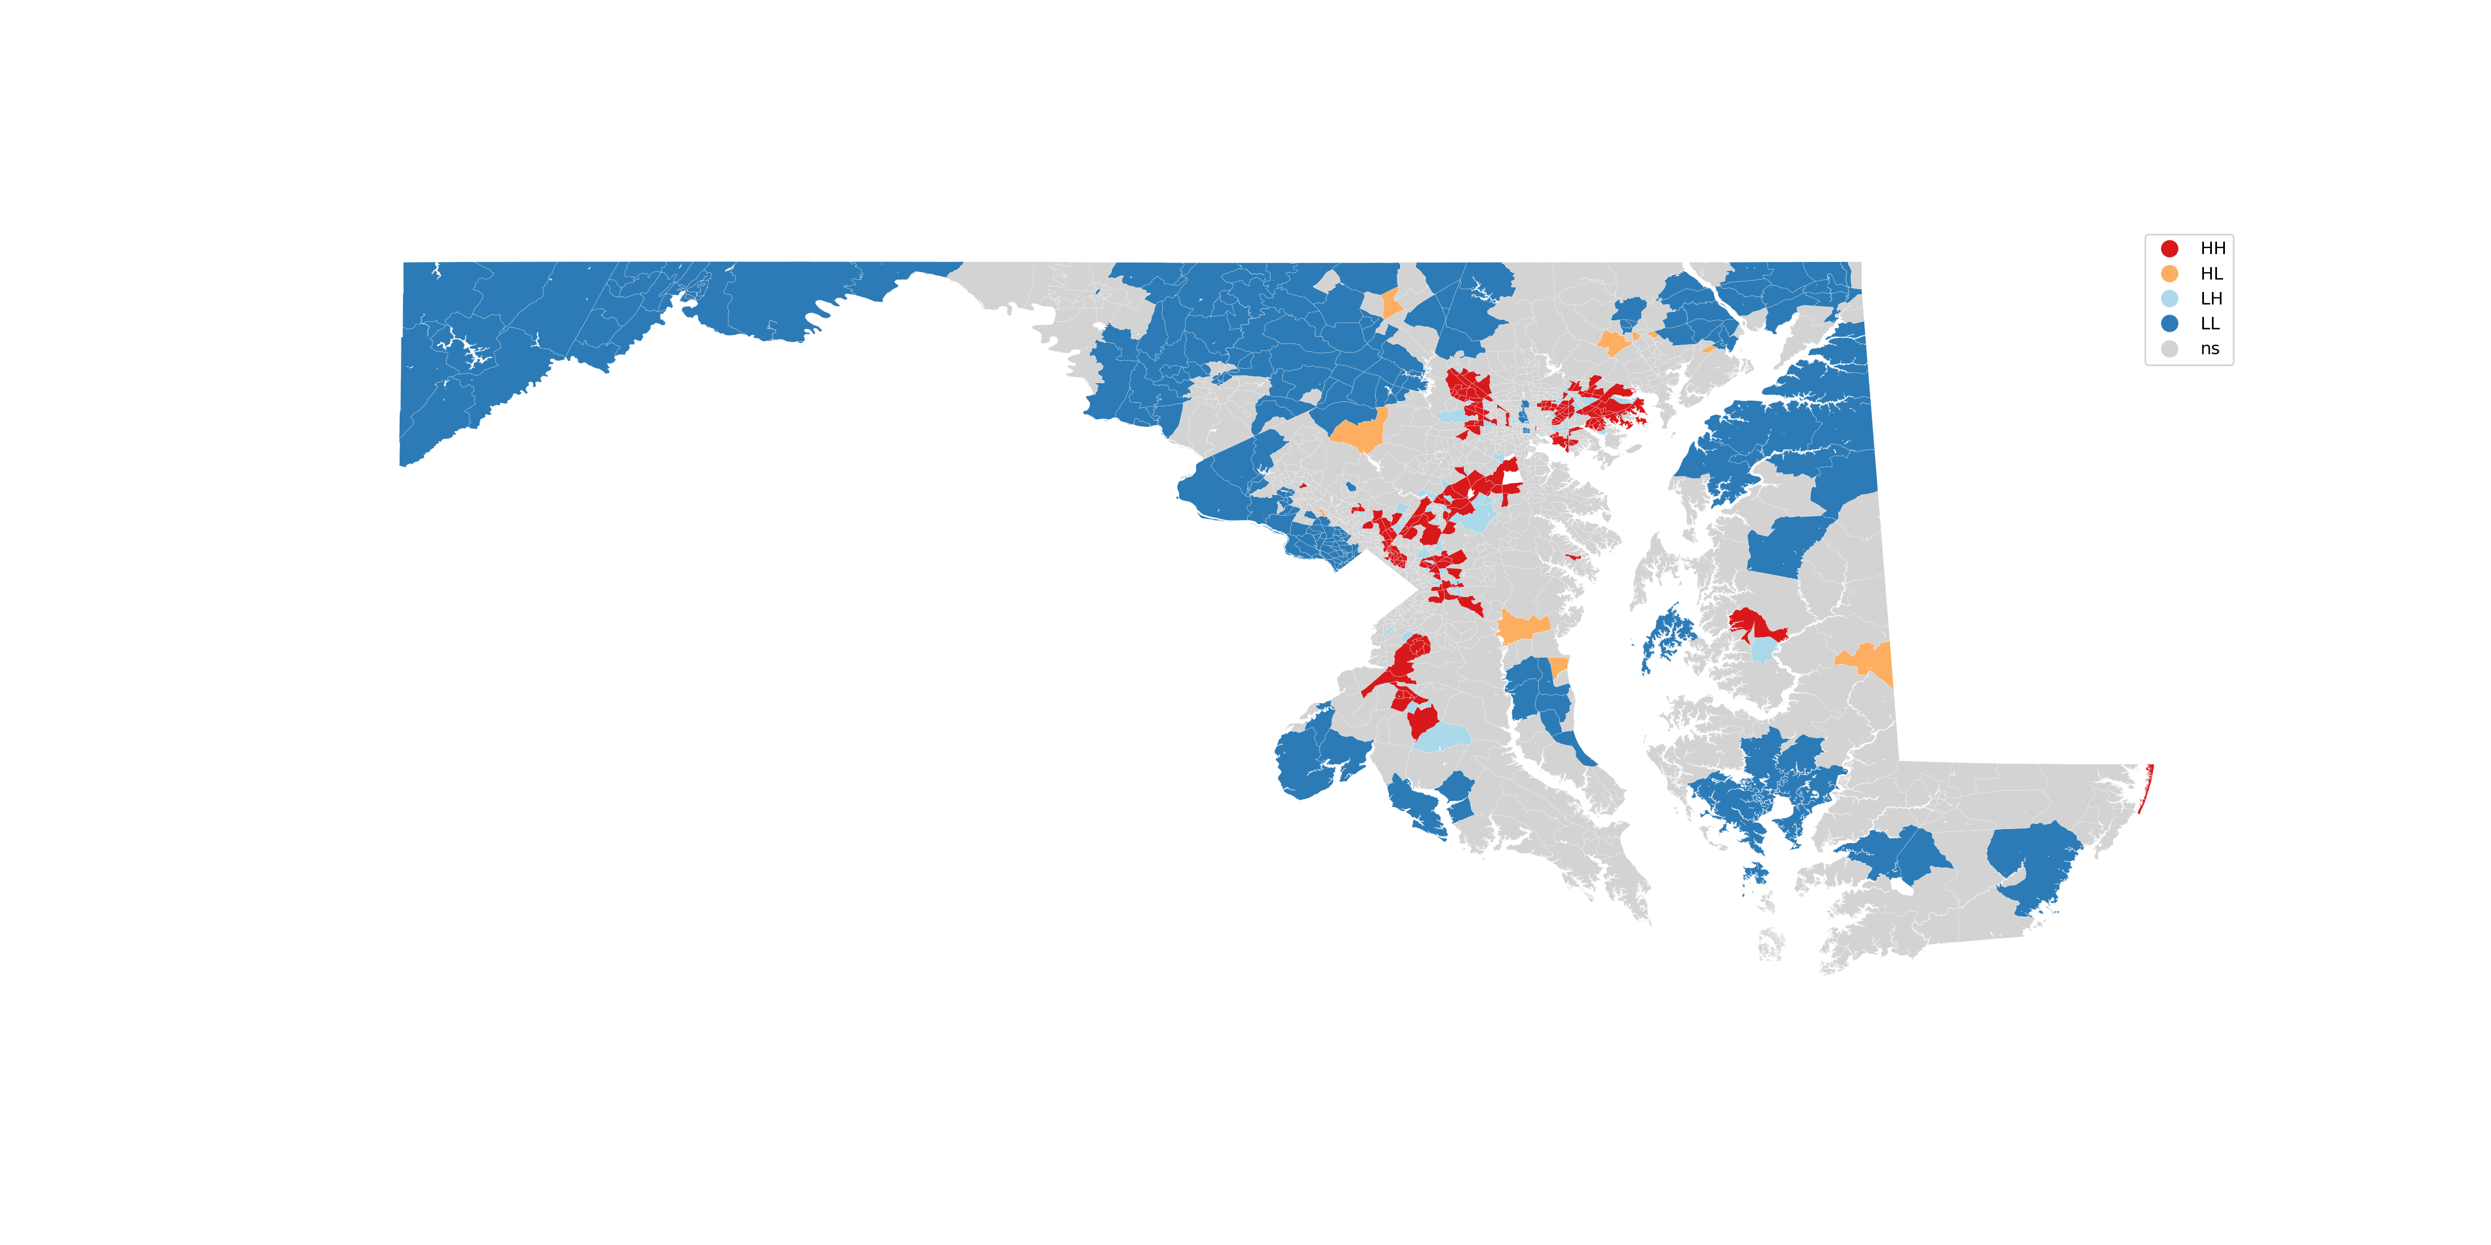
Hotspot analysis for new COVID-19 positive cases 03/15 – 06/30
Hotspot analysis for new COVID-19 positive cases 07/01 – 08/31
Notes:
Hotspots: clustered -> 5 separate locations

Slide 9
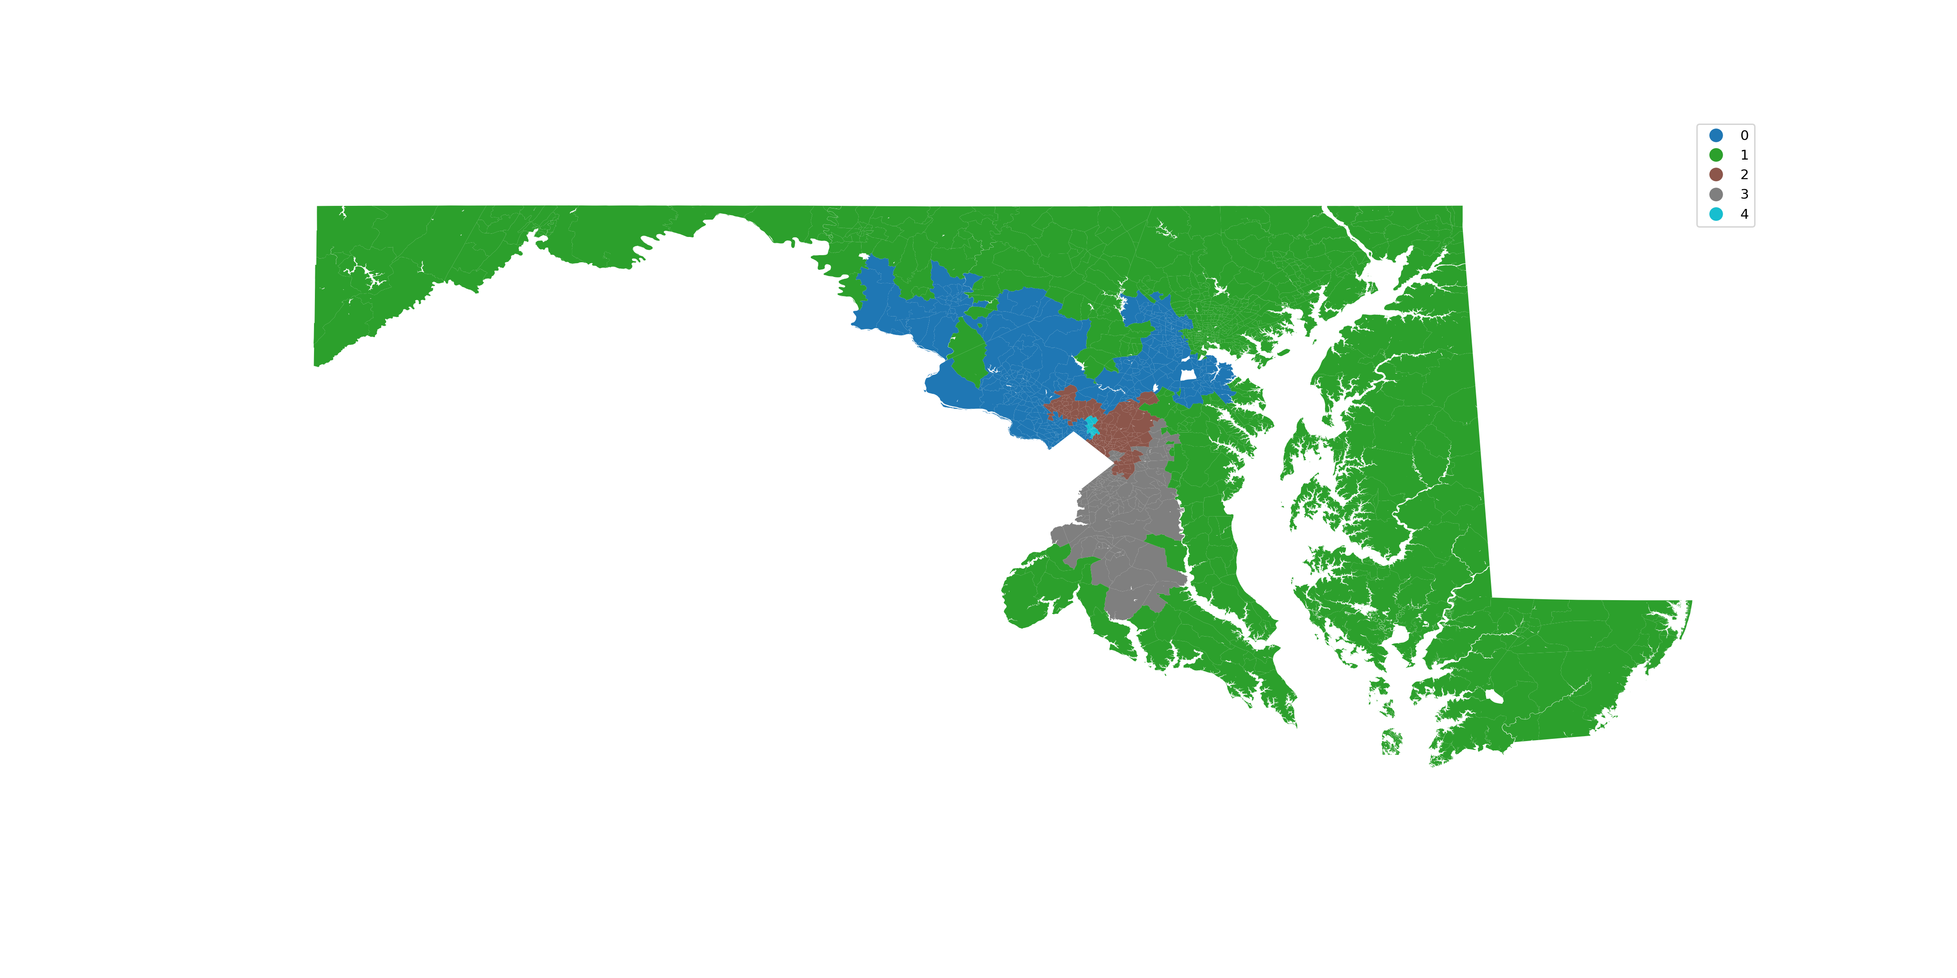
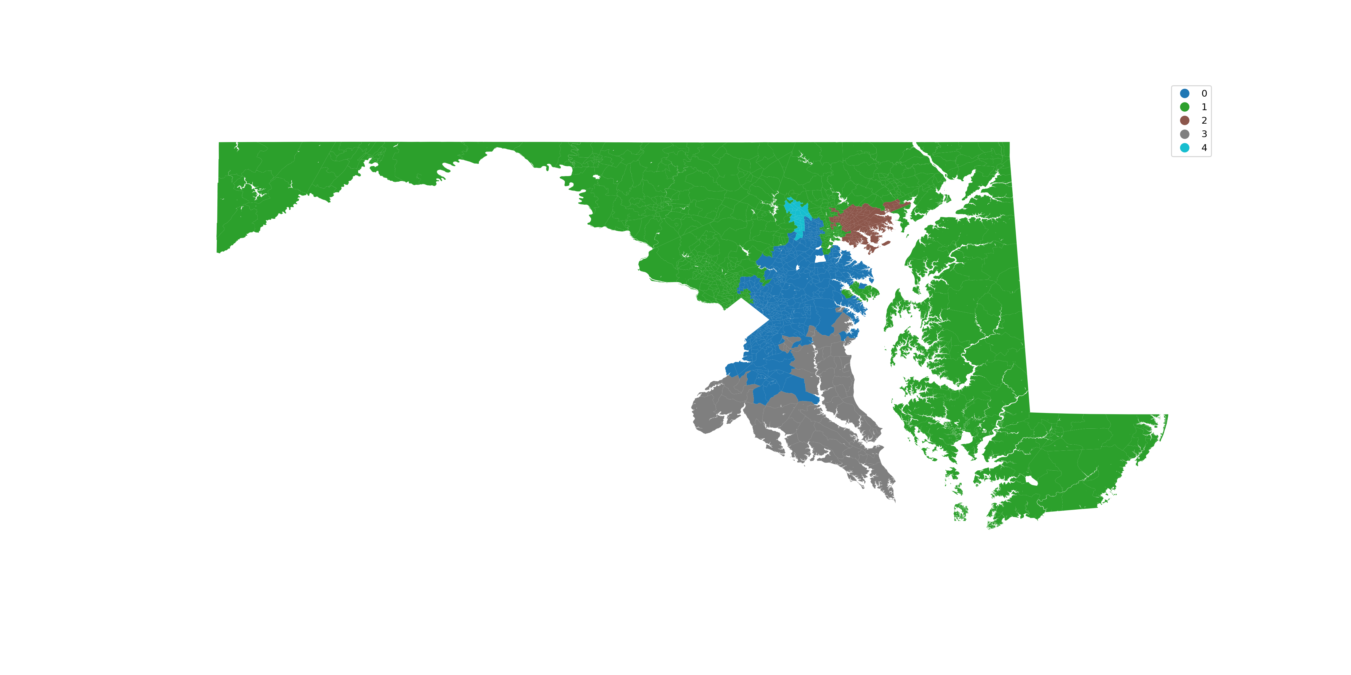
Regionalization for new COVID-19 positive cases 03/15 – 06/30
Regionalization for new COVID-19 positive cases 07/01 – 08/31
Notes:
The results might be wrong

Slide 10
Tentative Timeline
Week #10 (11/02)
Project Updates
Question and solutions
Week #11,12
Modified spatiotemporal analysis
Spatial analysis (GWR) Python coding and debugging
Week #13 (11/23)
Project Updates
Wee #14, 15
Other possible spatial analysis, e.g. hot spot, clustering, etc.
Week #16 (12/14)
Presentation and final report
Notes:
GWR & MGWR: maybe pick top 5 variables and the dependent variable

Slide 11
Thanks
Q&A

